Slide 1
Maximum Spherical Mean Value (mSMV) for Shadow Reduction
Alexandra Roberts
04/02/2022

Slide 2
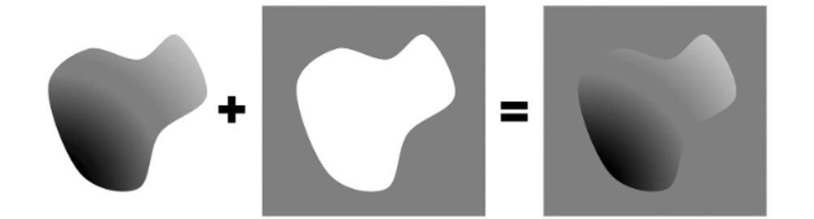
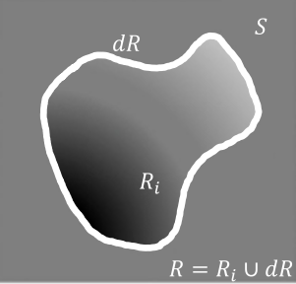



Green’s theorem (Fig. 1)
$$∂R$$
$$R_{i}$$
$$R=R_{i}∪∂R$$

Slide 3
Numerical simulation

Slide 4
Numerical simulation
Ground truth
PDF
SMV
SHARP
RESHARP
VSHARP
LBV
iSMV
mSMV

Slide 5
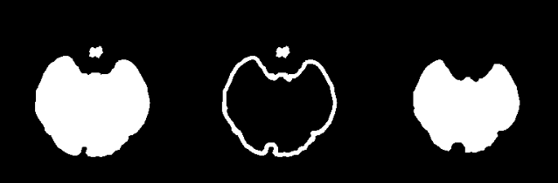


Mask schematic
Brain mask $M$ | Edge mask $M_{e}$ | Interior mask $M_{\sim e}$
$$b^{∗}$$
$$M=M_{e}∪M_{\sim e}$$ | $$∂M∈M_{e}$$ | $$S_{r=5}\left(b\right)=b_{SMV}$$

Slide 6


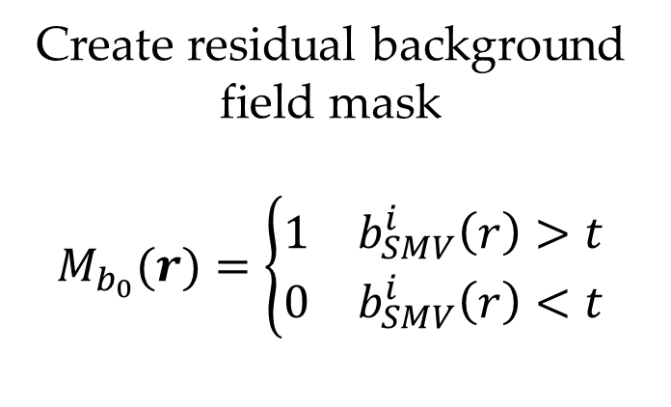


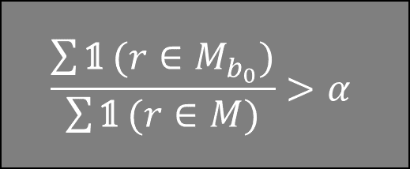

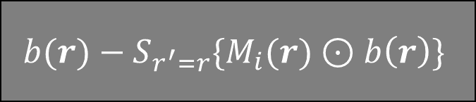


$$b_{L}(r)$$
$$b_{SMV}^{i}(r)$$
$$M_{b_{0}}\left(r\right)$$
$$b^{∗}$$
$$b_{L}(r)$$
$$b^{∗}$$
Apply SMV
Create residual background field mask
$$M_{b_{0}}(r)=\left\{\begin{aligned}\begin{matrix}1 & b_{SMV}^{i}\left(r\right)>t\end{matrix} \\ \begin{matrix}0 & b_{SMV}^{i}\left(r\right)<t\end{matrix}\end{aligned}\right.$$
$$b(r)−S_{r^{′}=r}\{M_{i}(r)⊙b\left(r\right)\}$$
$$\frac{\sum{\text{𝟙} (r∈M_{b_{0}})}}{\sum{\text{𝟙} (r∈M)}}>α$$
Iterate until residual background field is sufficiently small
$$b_{mSMV}(r)$$
$$χ_{mSMV}(r)$$
Reconstruct QSM

Slide 7
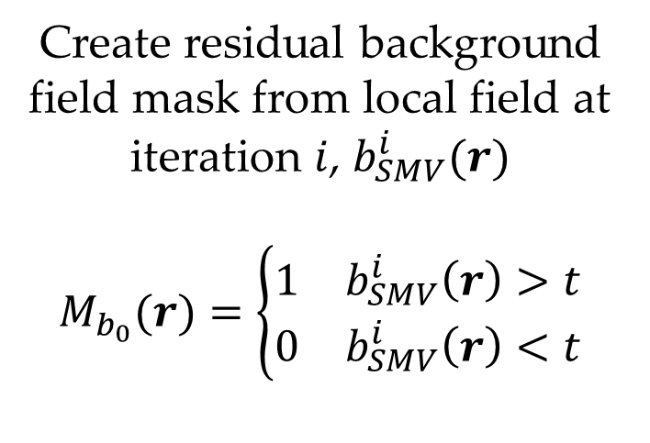
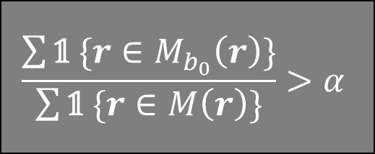
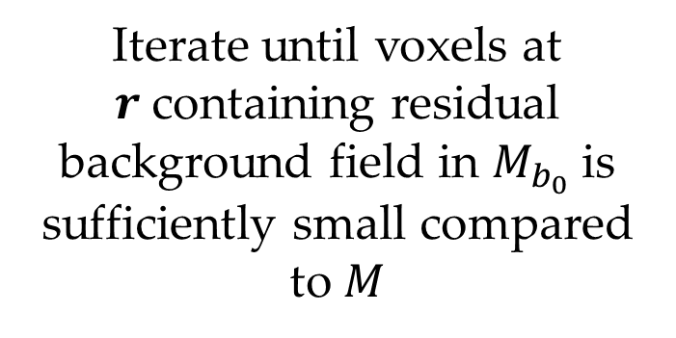

$$b_{L}(r)$$
$$b_{SMV}^{i}(r)$$
$$M_{b_{0}}\left(r\right)$$
$$b^{∗}$$
$$b_{L}(r)$$
$$b^{∗}$$
Create residual background field mask from local field at iteration $i$, $b_{SMV}^{i}(r)$
$$M_{b_{0}}(r)=\left\{\begin{aligned}\begin{matrix}1 & b_{SMV}^{i}\left(r\right)>t\end{matrix} \\ \begin{matrix}0 & b_{SMV}^{i}\left(r\right)<t\end{matrix}\end{aligned}\right.$$
Apply SMV at iteration $i$
$$b(r)−S_{r^{′}=r}\{M_{i}(r)⊙b\left(r\right)\}$$
$$\frac{\sum{\text{𝟙} \{r∈M_{b_{0}}\left(r\right)\}}}{\sum{\text{𝟙} \{r∈M\left(r\right)\}}}>α$$
Iterate until voxels at $r$containing residual background field in $M_{b_{0}}$ is sufficiently small compared to $M$
$$b_{mSMV}(r)$$
$$χ_{mSMV}(r)$$
Reconstruct QSM

Slide 8
Healthy subjects
PDF | mSMV | SMV | VSHARP

Slide 9
Healthy subjects (old)
PDF | mSMV | SMV | LBV | VSHARP

Slide 10
Healthy subjects
PDF | mSMV | SMV | LBV | VSHARP

Slide 11
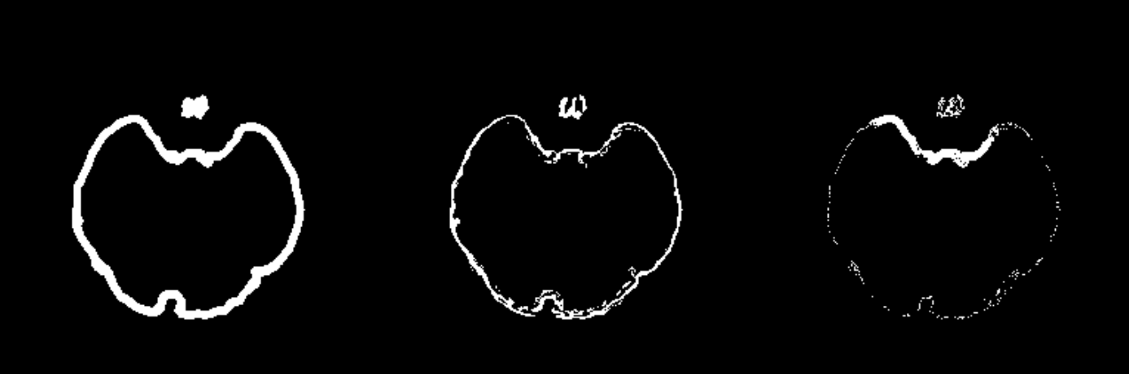
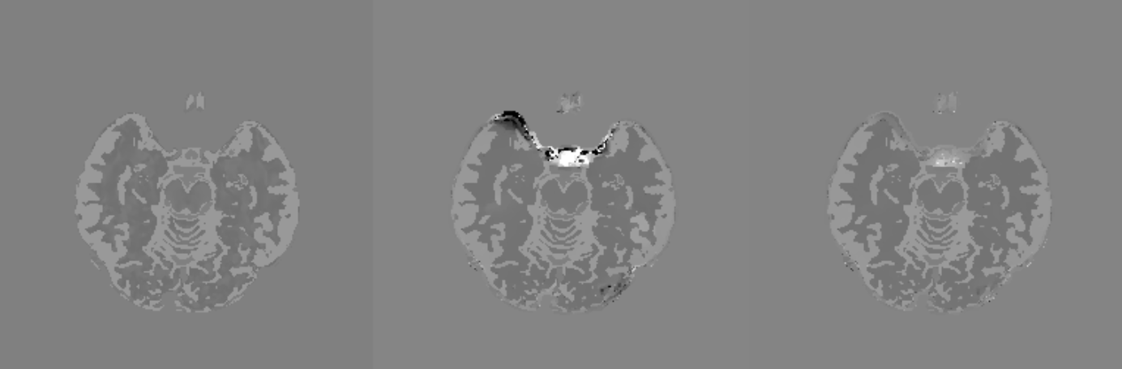
Field map uncertainty mask

Slide 12
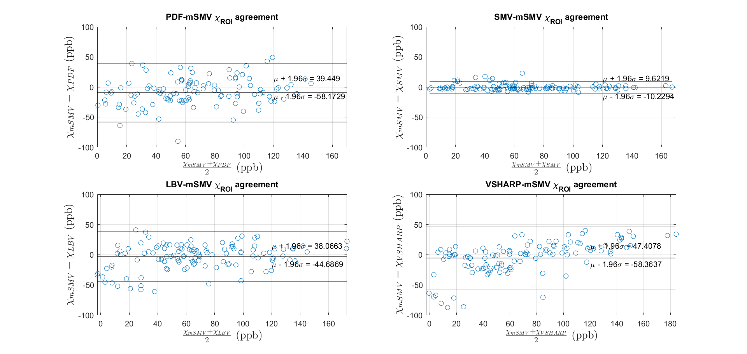
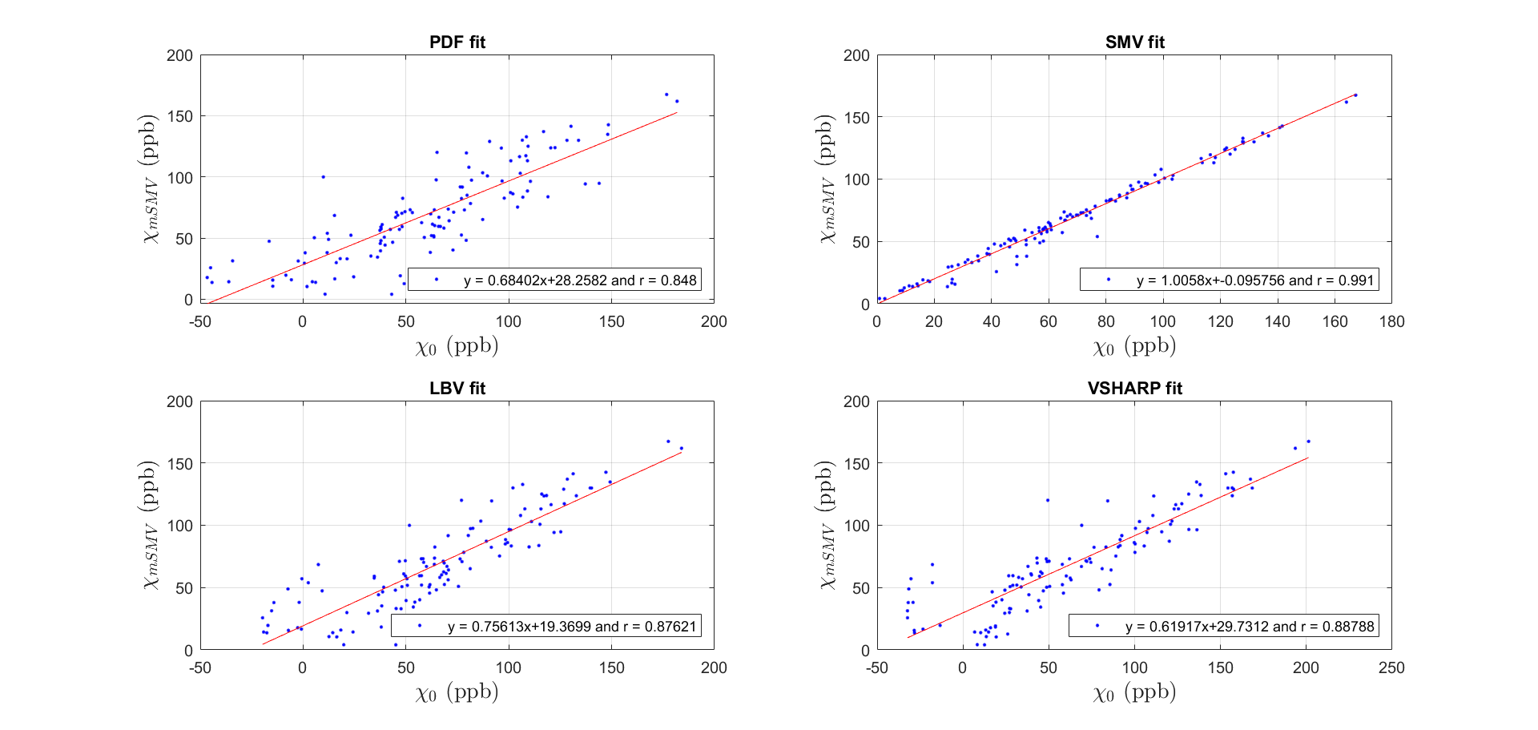
Fit and Bland-Altman plots Subcortical gray matter ROIs

Slide 13
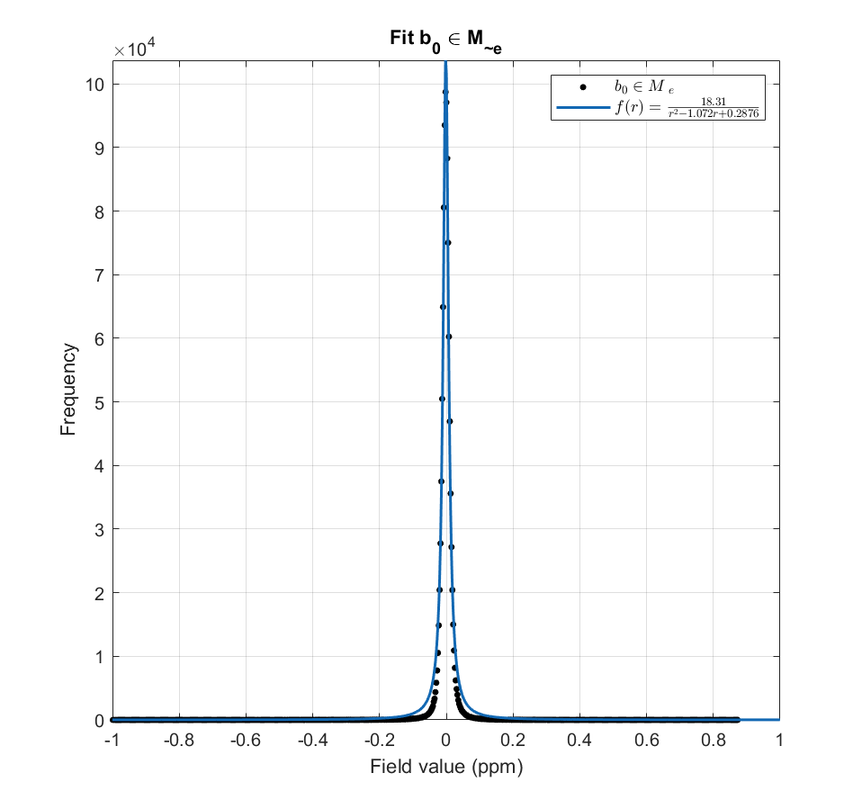
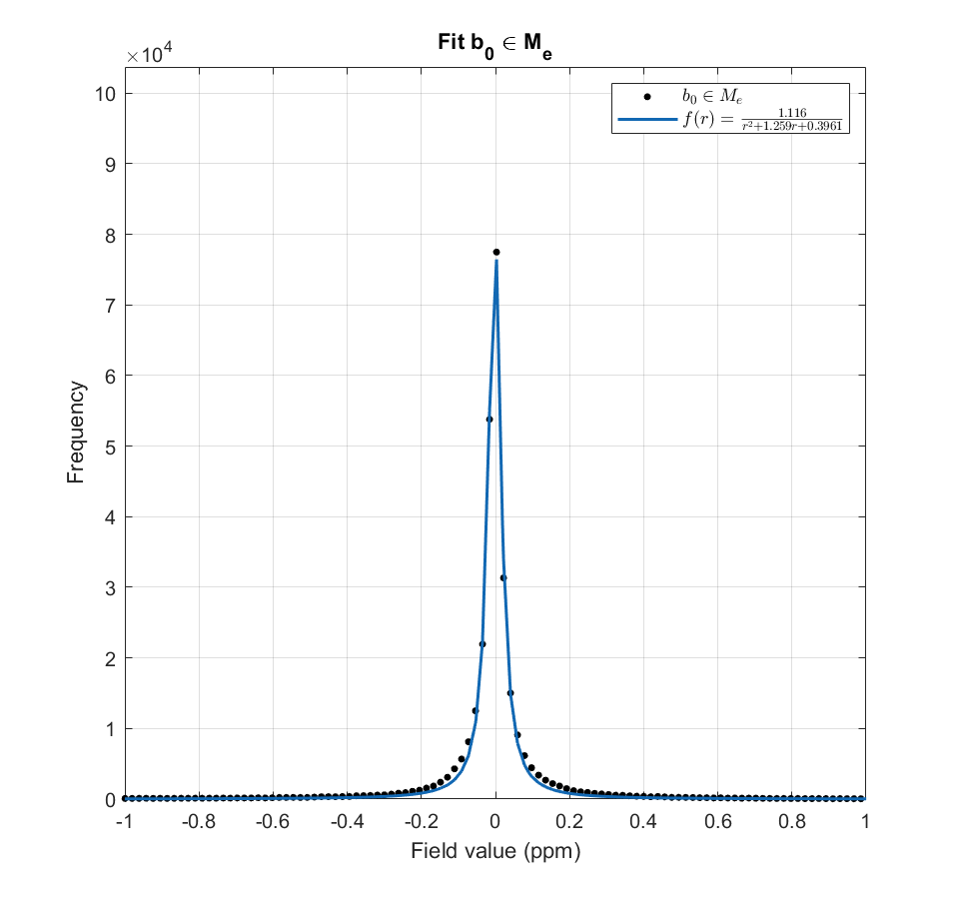

Residual field distribution
$b\left(r\right)=d\left(r\right)∗χ\left(r\right)=$ $\frac{2z^{2}−x^{2}−y^{2}}{4π{\left|r\right|}^{2}}∗χ(r)$
$$b_{0}\left(r\right)=M_{e}⊙(b_{SMV}\left(r\right)−b_{local}\left(r\right))$$
Residual background field $b_{0}$ rational fit

Slide 14
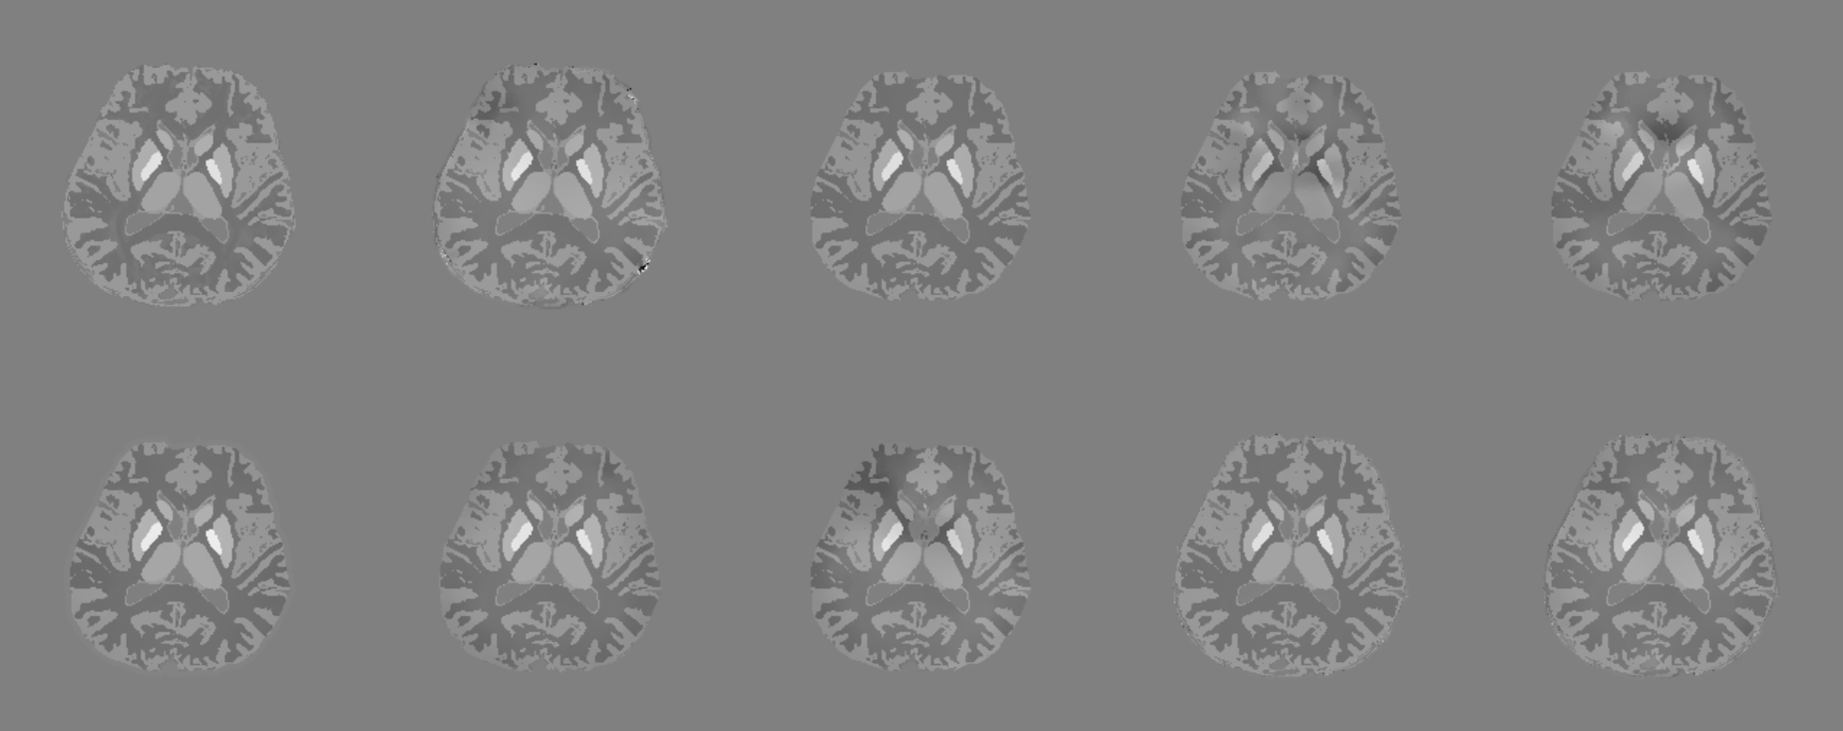
Direct application of mSMV
Ground truth | PDF | SMV | SHARP | RESHARP
VSHARP | LBV | iSMV | mSMV | dmSMV

Slide 15
Appendix

Slide 16
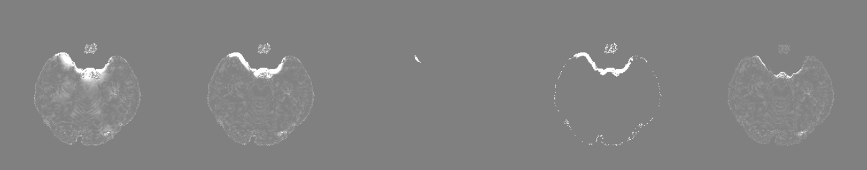
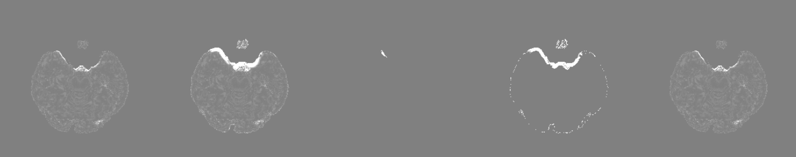
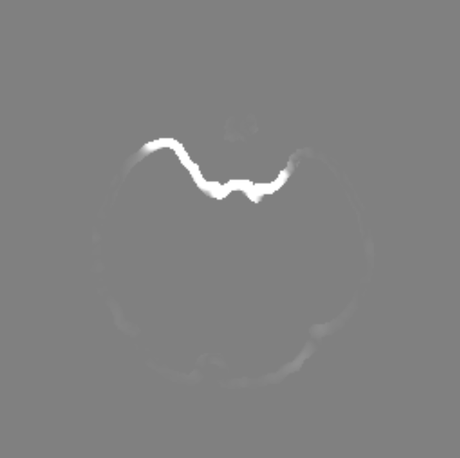
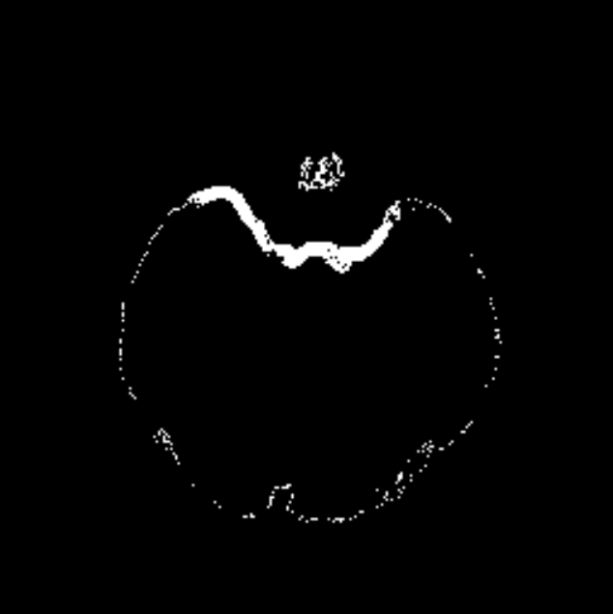
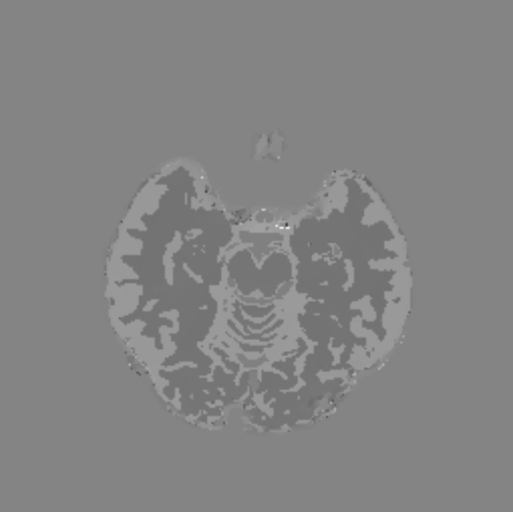





$$\left|b^{∗}\right|∈∂M$$
$$b_{SMV}=b_{L}−S_{r=5}b_{L}$$
Identify residual background field
$$M_{e}⊙|b_{L}−b_{SMV}|$$
Apply SMV
a)
b)
c)
Compute residual background field mask
$$M_{b_{B}}=\left\{\begin{aligned}\begin{matrix}1 & \left|b_{SMV}\right|>η, r∈M_{e}\end{matrix} \\ \begin{matrix}0 & else \end{matrix}\end{aligned}\right.$$
Rescale residual background field
$$b_{mSMV}=(1−M_{b_{B}})⊙b_{SMV}+{M_{b_{B}}⊙b′}_{SMV}$$
$$χ_{mSMV}$$
MEDI-L1
d)
e)
f)

Slide 17
Numerical simulation
Ground truth
PDF
SMV
SHARP
RESHARP
VSHARP
iSMV
LBV
mSMV

Slide 18
Maximum corollary of Green’s theorem (Fig. 2)

Slide 19
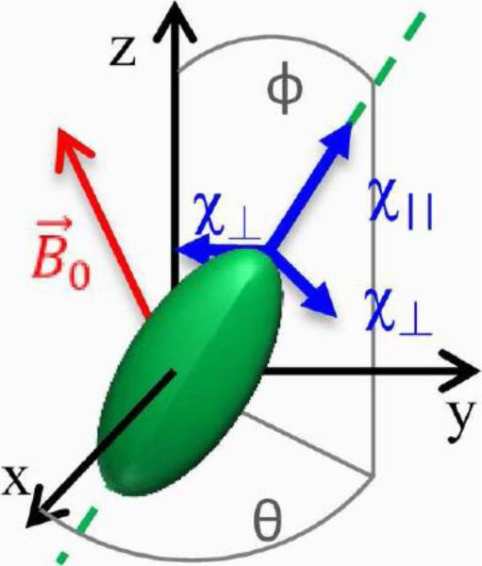
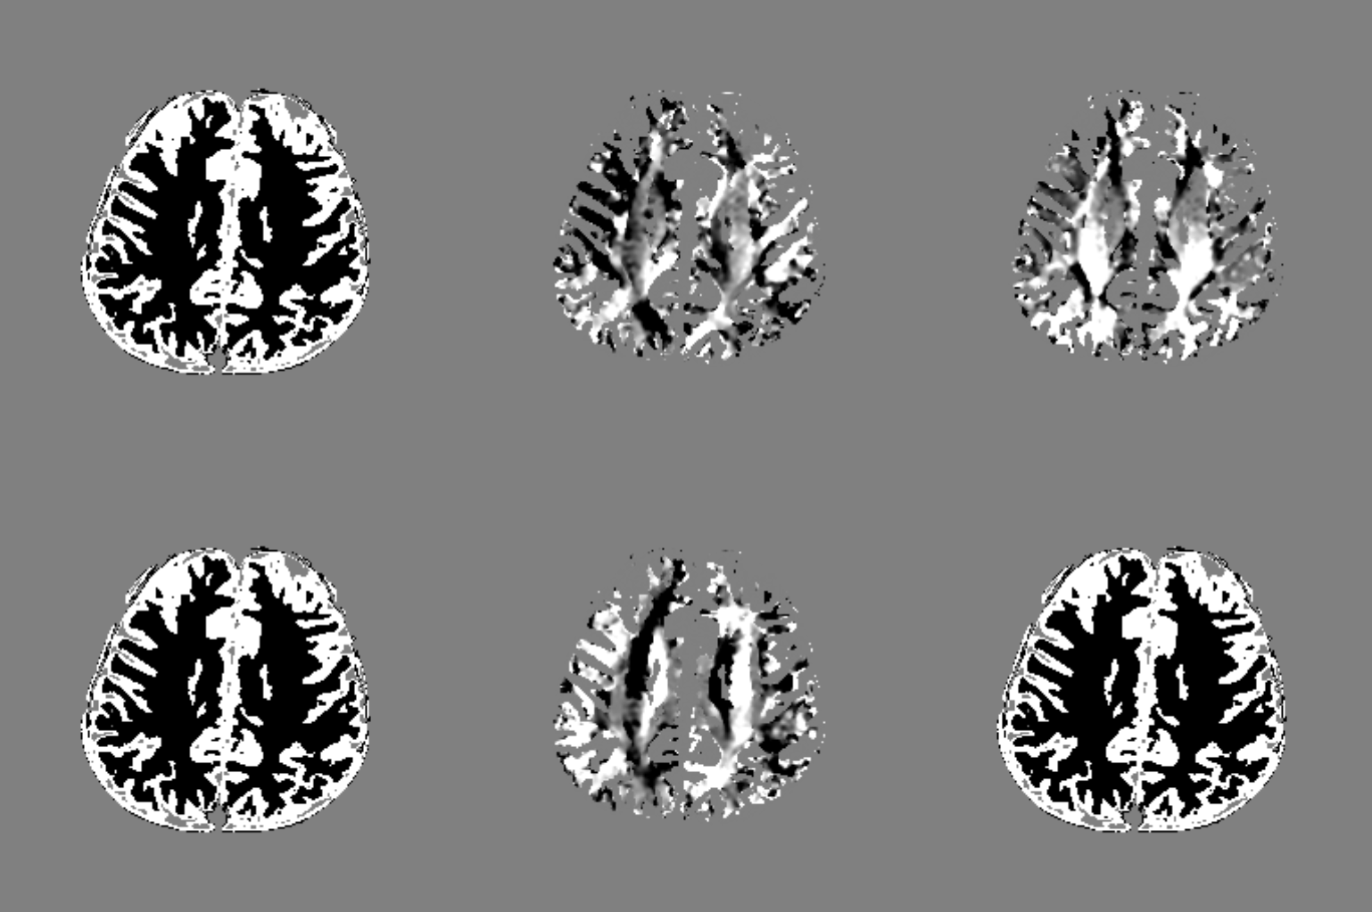
Numerical brain

Slide 20
Axial numerical brain
Ground truth
Control
SMV
SHARP
RESHARP
VSHARP
LBV
iSMV
mSMV
Ground truth
Control
SMV
SHARP
RESHARP
VSHARP
LBV
iSMV
mSMV

Slide 21
Sagittal and coronal numerical brain
Ground truth
Control
SMV
SHARP
RESHARP
VSHARP
LBV
iSMV
mSMV
Ground truth
Control
SMV
SHARP
RESHARP
VSHARP
LBV
iSMV
mSMV

Slide 22
Numerical brain multi-view (Fig. 3)
Ground truth
Control
SMV
Ground truth
Control
SMV
SHARP
RESHARP
VSHARP
SHARP
RESHARP
VSHARP
LBV
iSMV
mSMV
LBV
iSMV
mSMV
Ground truth
Control
SMV
Ground truth
Control
SMV
SHARP
VSHARP
SHARP
RESHARP
VSHARP
RESHARP
VSHARP
LBV
iSMV
mSMV
LBV
iSMV
mSMV
mSMV

Slide 23
Numerical brain multi-view (Fig. 3)
Ground truth
PDF
SMV
SHARP
RESHARP
VSHARP
LBV
iSMV
mSMV

Slide 24
Numerical brain multi-view (Fig. 3)
Ground truth | PDF | mPDF | SHARP | RESHARP | VSHARP | LBV | SMV | iSMV | mSMV

Slide 25
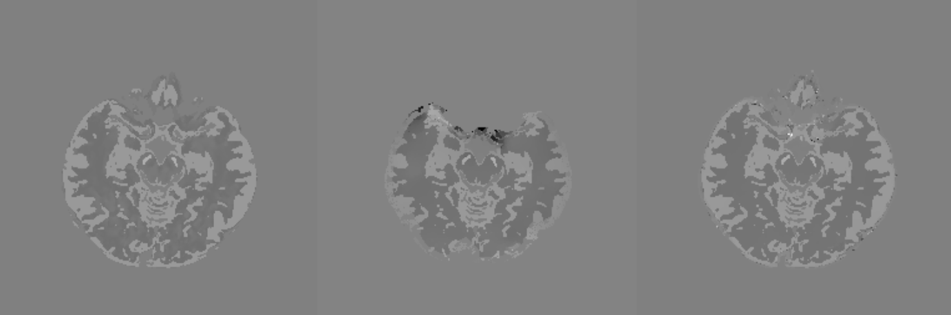
Phase uncertainty map (Fig. 4)
Ground truth | Phase uncertainty mask | Background field mask

Slide 26
Hemorrhage numerical brain
Ground truth
Control
SMV
mSMV
Ground truth
Control
SMV
mSMV

Slide 27
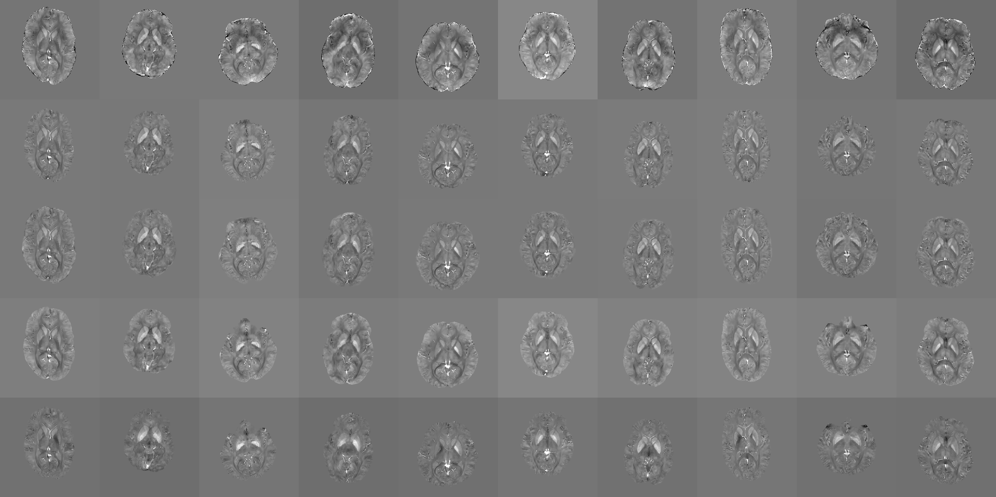
Healthy subjects

Slide 28
Hemorrhage subjects
Control
SMV
mSMV

Slide 29
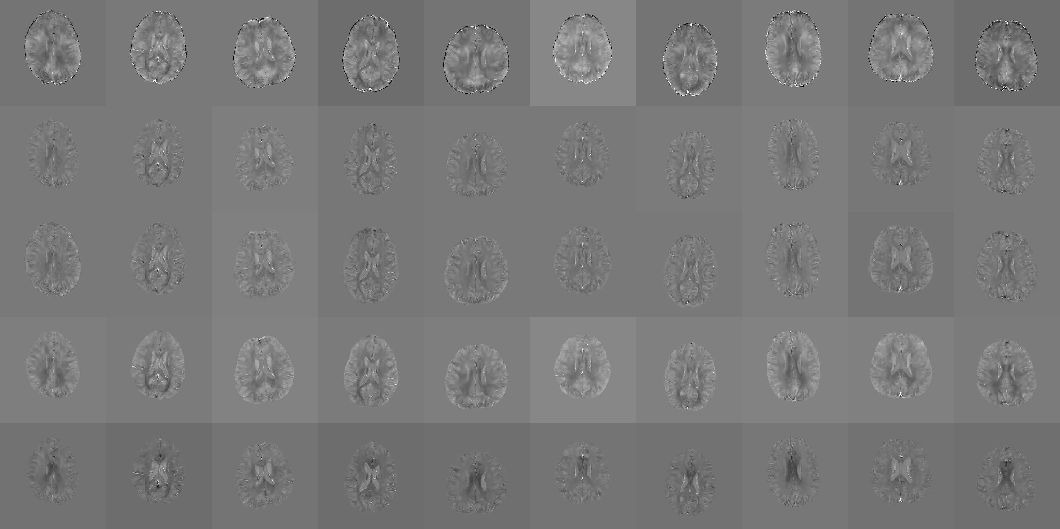
Healthy subjects

Slide 30
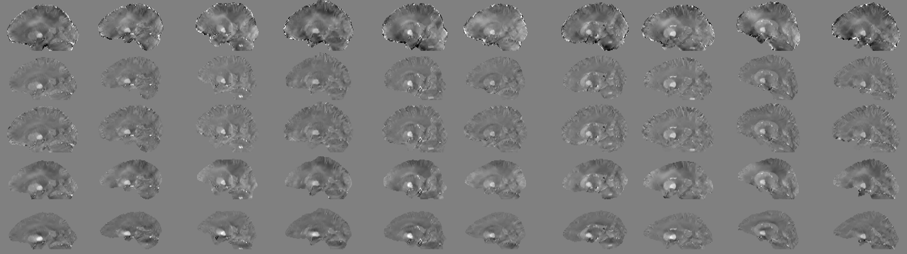
Healthy subjects

Slide 31
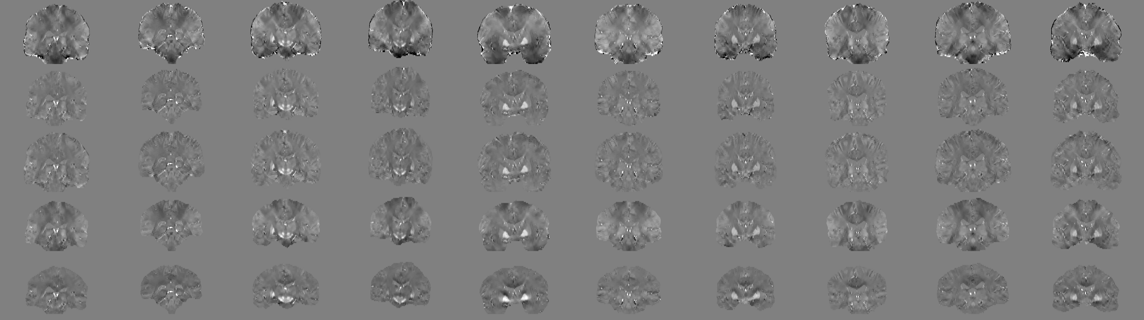
Healthy subjects

Slide 32
Healthy subject 5 (old)
Control
mSMV
LBV
VSHARP

Slide 33
Healthy subject 10 (old)
Control
mSMV
LBV
VSHARP

Slide 34
Healthy subjects combined (Fig. 5)
Control
mSMV
SMV
LBV
VSHARP
PDF

Slide 35
Healthy subjects
mSMV
mPDF
SMV
VSHARP
PDF
LBV

Slide 36
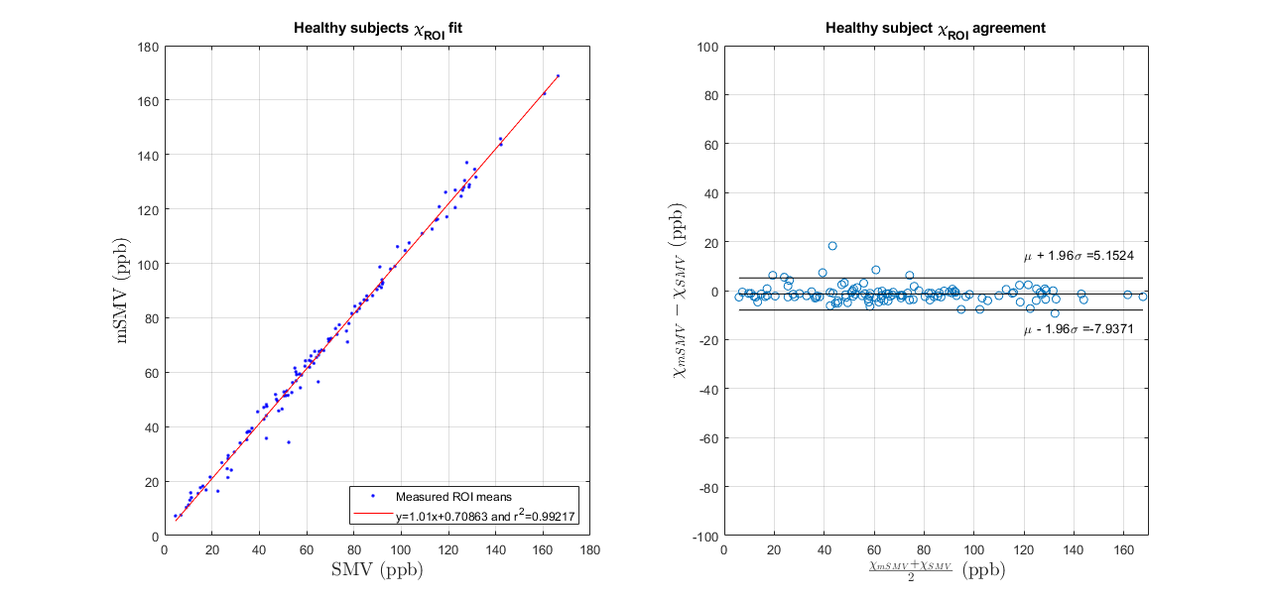
Healthy subjects SMV comparison (Fig. 6)

Slide 37
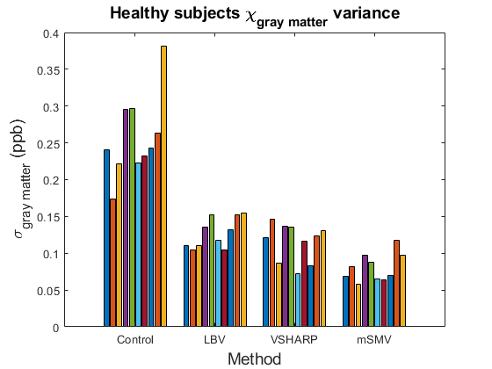
Healthy subjects shadow score

Slide 38
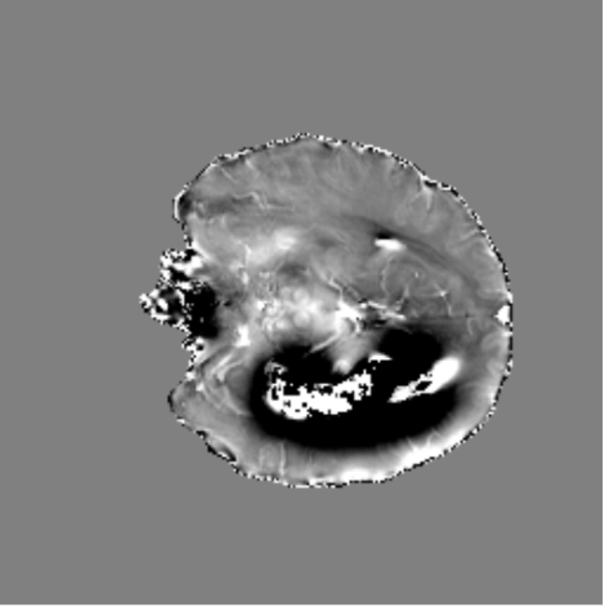
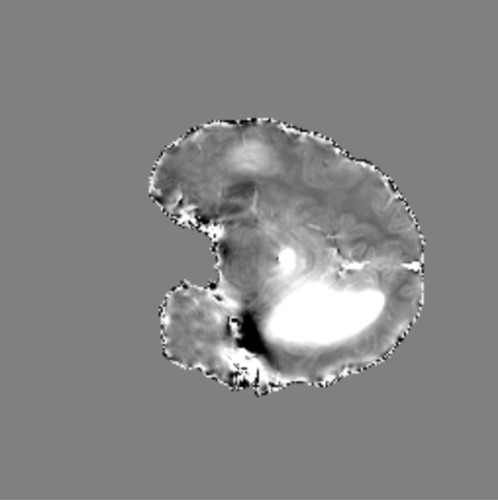
Hemorrhage case

Slide 39




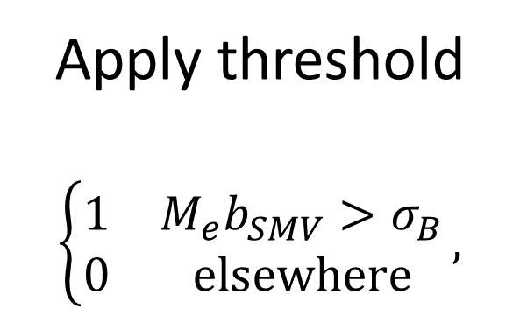
$$b_{maximum}$$
$$\text{\sim }\text{𝒩}\text{(}μ_{B},σ_{B}^{2})$$
$$M_{b_{B}}$$
Region grow
Apply threshold
$$\left\{\begin{matrix}1 & M_{e}b_{SMV}>σ_{B} \\ 0 & elsewhere\end{matrix}\right.,$$
Fit distribution
a)
b)
c)
$$b_{SMV}=b_{L}−S_{r=5}b_{L}$$
$$b_{mSMV}=b_{SMV}−{M_{b_{B}}b}_{SMV}$$
$$χ_{mSMV}$$
Remove residual background field
MEDI-L1
d)
e)
f)

Slide 40
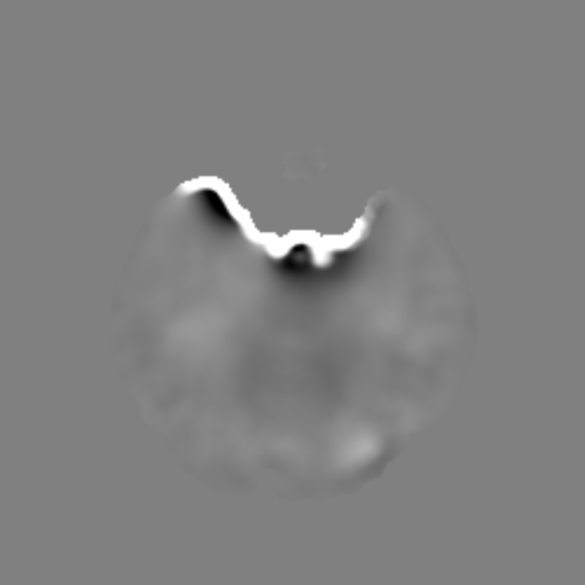
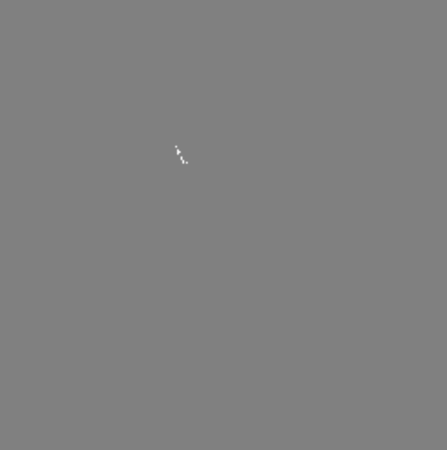
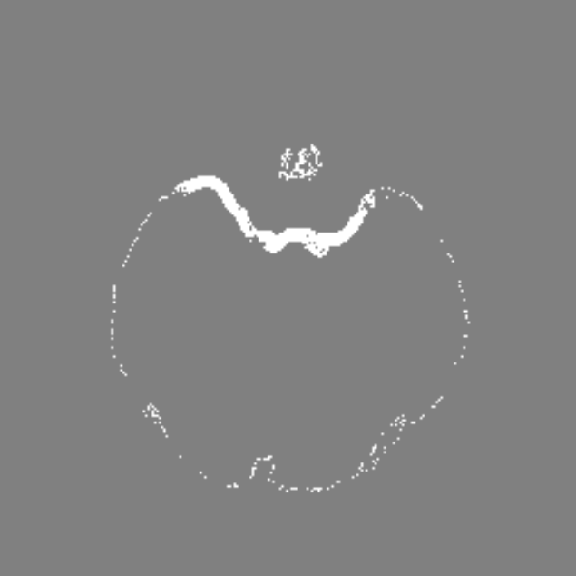
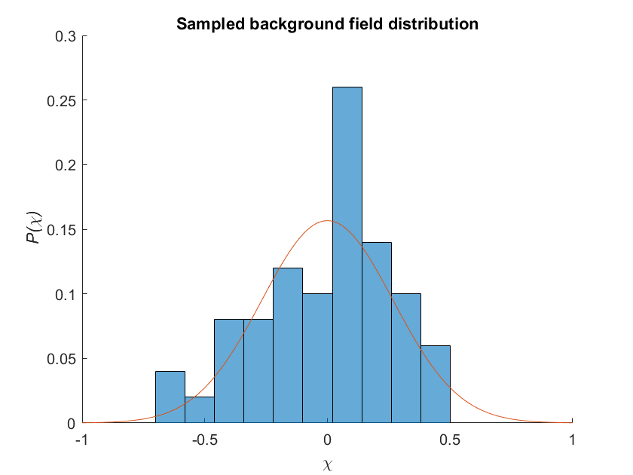

$${|b−b_{SMV}|}_{maximum}$$
$$\text{\sim }\text{𝒩}\text{(}μ_{B},σ_{B}^{2})$$
$$M_{b_{B}}$$
Region grow
Apply threshold
$$\left\{\begin{matrix}1 & M_{e}b_{SMV}>σ_{B} \\ 0 & elsewhere\end{matrix}\right.,$$
Fit distribution
a)
b)
c)
$$b_{SMV}=b_{L}−S_{r=5}b_{L}$$
$$b_{mSMV}=b_{SMV}−{M_{b_{B}}b}_{SMV}$$
$$χ_{mSMV}$$
Remove residual background field
MEDI-L1
d)
e)
f)

Slide 41
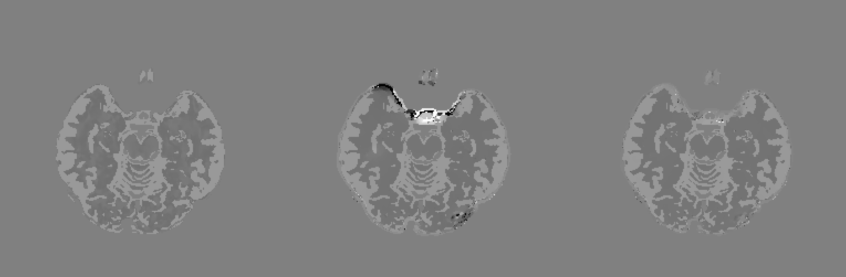
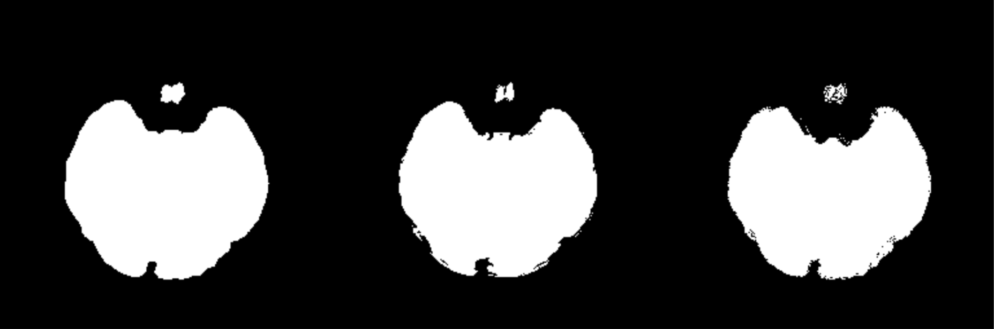
Robust mask experiment
Ground Truth | Robust Mask | mSMV Background Mask

Slide 42

Magic function
Assume the sampled residual background field is normally distributed
$$J(b−b_{SMV})\sim 𝒩(μ_{B},σ_{B}^{2})$$
Mean shift
$$J(b−b_{SMV})\sim 𝒩(0,σ_{B}^{2})$$
Call region-growing parameter $η$ and generate global threshold
$$ρ=\min{(ησ_{B},(1−ησ_{B})})$$
Apply threshold
$$M_{b_{B}}=\left\{\begin{matrix}1 & M_{e}b_{SMV}>ρ \\ 0 & else\end{matrix}\right.$$

Slide 43
Magic function implementation
function msmv(in_file,out_file)
% Load local field
load(in_file)
% Initial region-growing parameter
rg_param = 0.1;
% Generate kernel
SphereK = single(sphere_kernel(matrix_size, voxel_size,5));
% Partition mask
Mask_ne = SMV(Mask,SphereK) > 0.999;
Mask_e = Mask-Mask_ne;
% Partition field
RDF_ne = Mask_ne.*(RDF);
RDF_e = Mask_e.*(RDF);
% Find max, on edge via Green's theorem
[maxval,idxmax] = max(RDF(:));
[r,c,p] = ind2sub(size(RDF),idxmax);
% Perform initial SMV, then address incorrect values at edge
RDF_s0 = Mask.*(RDF-SMV(RDF,SphereK));
% Region grow from max seed point, output residual background field mask J
[P,J] = regionGrowing(abs(RDF_s0),[r c p],rg_param*max(RDF_s0(:)),min(matrix_size(:)).*min(voxel_size(:)));
while sum(J(:)) < (1/2)*min(matrix_size)
rg_param = 1.1*rg_param;
[P,J] = regionGrowing(abs(RDF_s0),[r c p],rg_param*max(abs(RDF_s0(:))),min(matrix_size(:)).*min(voxel_size(:)));
end
% Fit normal distribution to difference in original and filtered local field in known background field mask
RDF_bk = abs(RDF-RDF_s0).*J;
RDF_bk = abs(RDF_bk(abs(J(:))>0));
f_bk = fitdist(RDF_bk(:)-mean(RDF_bk(:)),'normal');
f_ne = fitdist(RDF_ne(:)-mean(RDF_ne(:)),'normal');
% Create global mask of residual background field
Mask_bk = imbinarize(abs(Mask_e.*RDF_s0),min(f_bk.sigma.*rg_param,(f_bk.sigma.*(1-rg_param))));
disp('Residual background field threshold in radians is:')
disp(string(min(f_bk.sigma.*rg_param,(f_bk.sigma.*(1-rg_param)))))
RDF_s = Mask.*(RDF_s0-Mask_bk.*RDF_s0);
RDF = RDF_s;
save(out_file,'B0_dir','CF','delta_TE','iFreq', 'iFreq_raw', 'iMag', 'Mask', 'Mask_CSF', 'matrix_size', 'N_std', 'RDF', 'voxel_size');
end

Slide 44
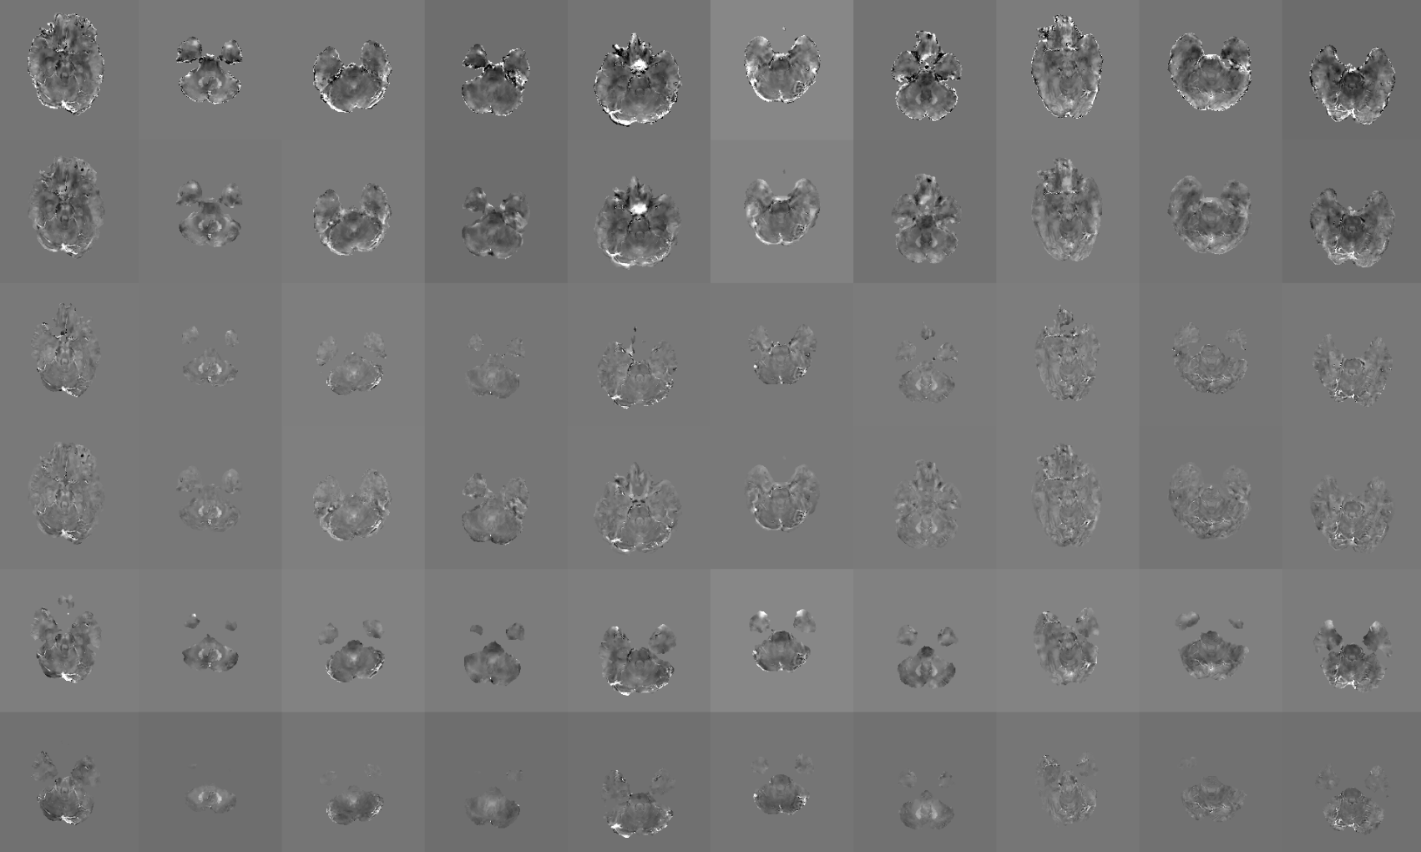
Magic function results

Slide 45
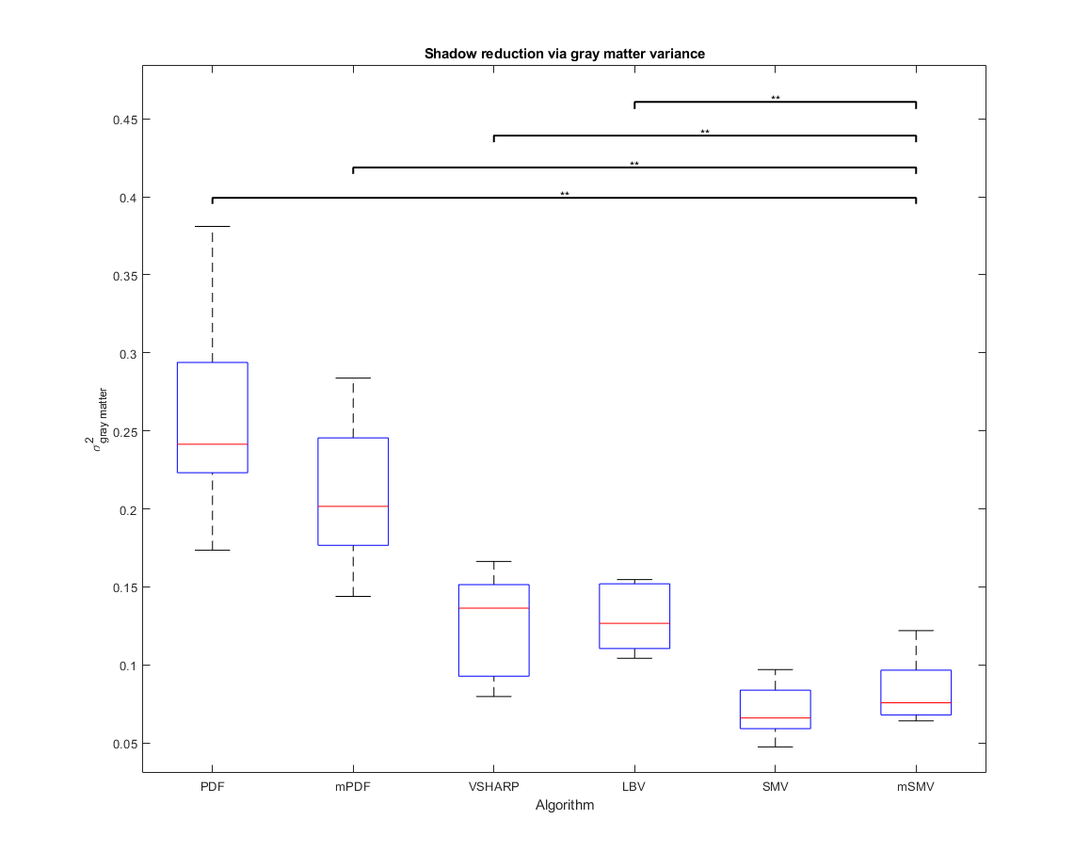
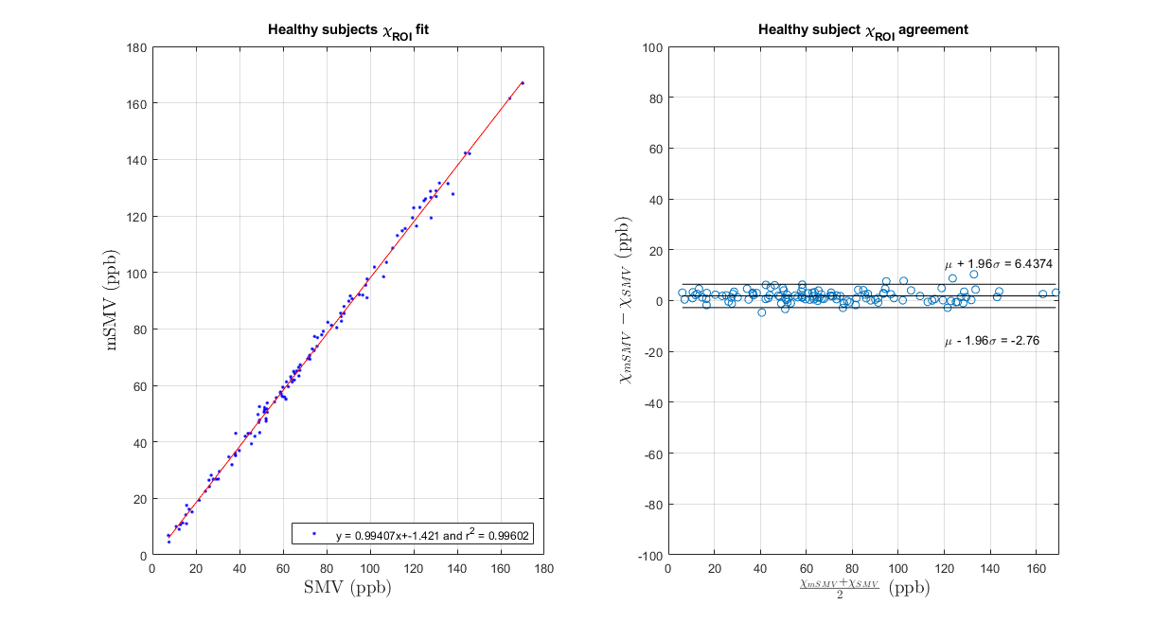
Magic function results

Slide 46
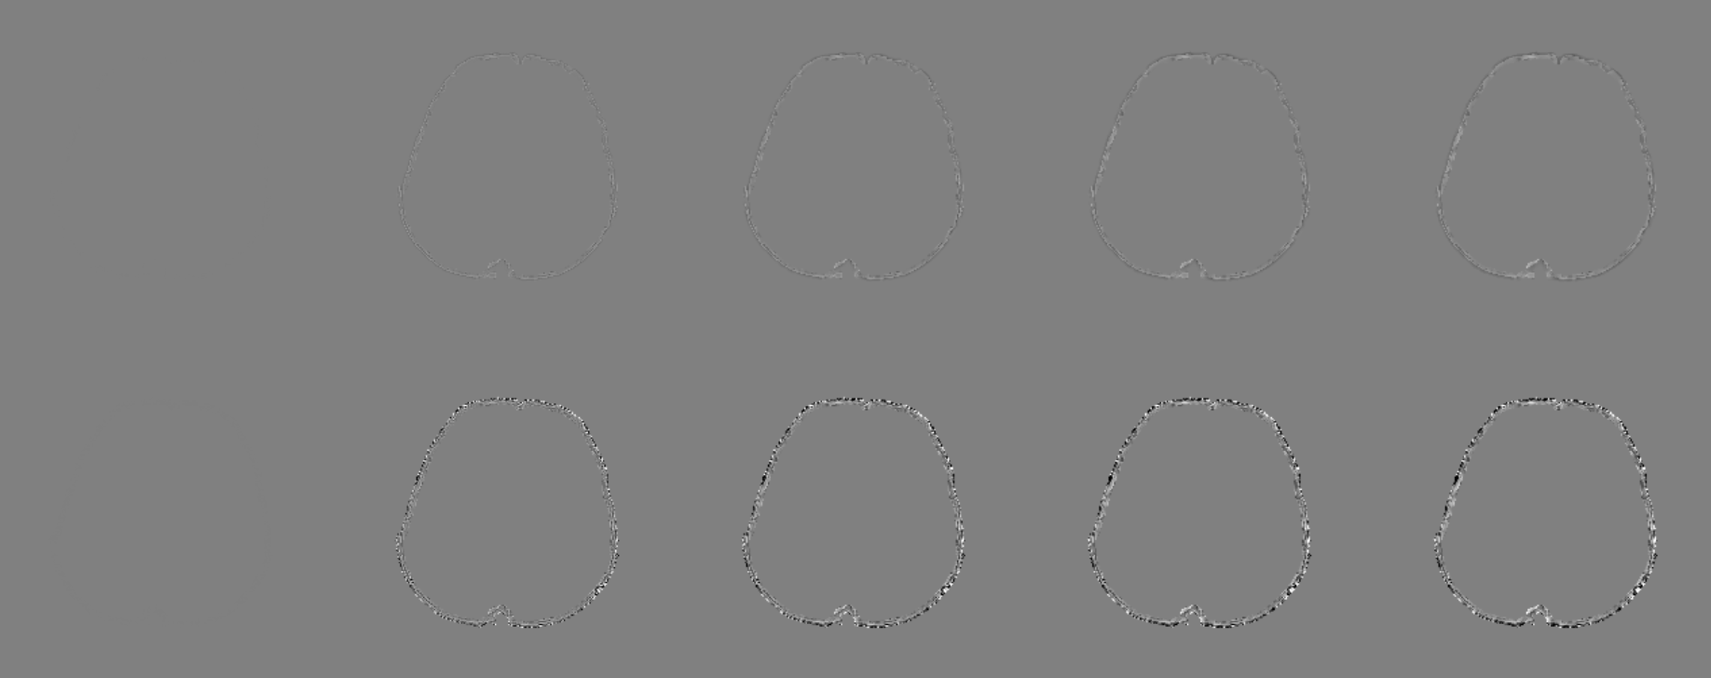
SMV filtered volumes
$$∂M{|b_{L}^{0}\left(\vec{r}\right)−S}_{r^{′}=1}\left\{b_{L}^{0}\left(\vec{r}\right)\right\}|→S_{r^{′}=1}\sim δ(\vec{r})$$ | $$∂M{|b_{L}^{0}\left(\vec{r}\right)−S}_{r^{′}=2}\left\{b_{L}^{0}\left(\vec{r}\right)\right\}|$$ | $$∂M{|b_{L}^{0}\left(\vec{r}\right)−S}_{r^{′}=3}\left\{b_{L}^{0}\left(\vec{r}\right)\right\}|$$ | $$∂M{|b_{L}^{0}\left(\vec{r}\right)−S}_{r^{′}=4}\left\{b_{L}^{0}\left(\vec{r}\right)\right\}|$$ | $$∂M{|b_{L}^{0}\left(\vec{r}\right)−S}_{r^{′}=5}\left\{b_{L}^{0}\left(\vec{r}\right)\right\}|$$
$$∂M{|b_{L}\left(\vec{r}\right)−S}_{r^{′}=1}\left\{b_{L}\left(\vec{r}\right)\right\}|→S_{r^{′}=1}\sim δ(\vec{r})$$ | $$∂M{|b_{L}\left(\vec{r}\right)−S}_{r^{′}=2}\left\{b_{L}\left(\vec{r}\right)\right\}|$$ | $$∂M{|b_{L}\left(\vec{r}\right)−S}_{r^{′}=3}\left\{b_{L}\left(\vec{r}\right)\right\}|$$ | $$∂M{|b_{L}\left(\vec{r}\right)−S}_{r^{′}=4}\left\{b_{L}\left(\vec{r}\right)\right\}|$$ | $$∂M{|b_{L}\left(\vec{r}\right)−S}_{r^{′}=5}\left\{b_{L}\left(\vec{r}\right)\right\}|$$

Slide 47
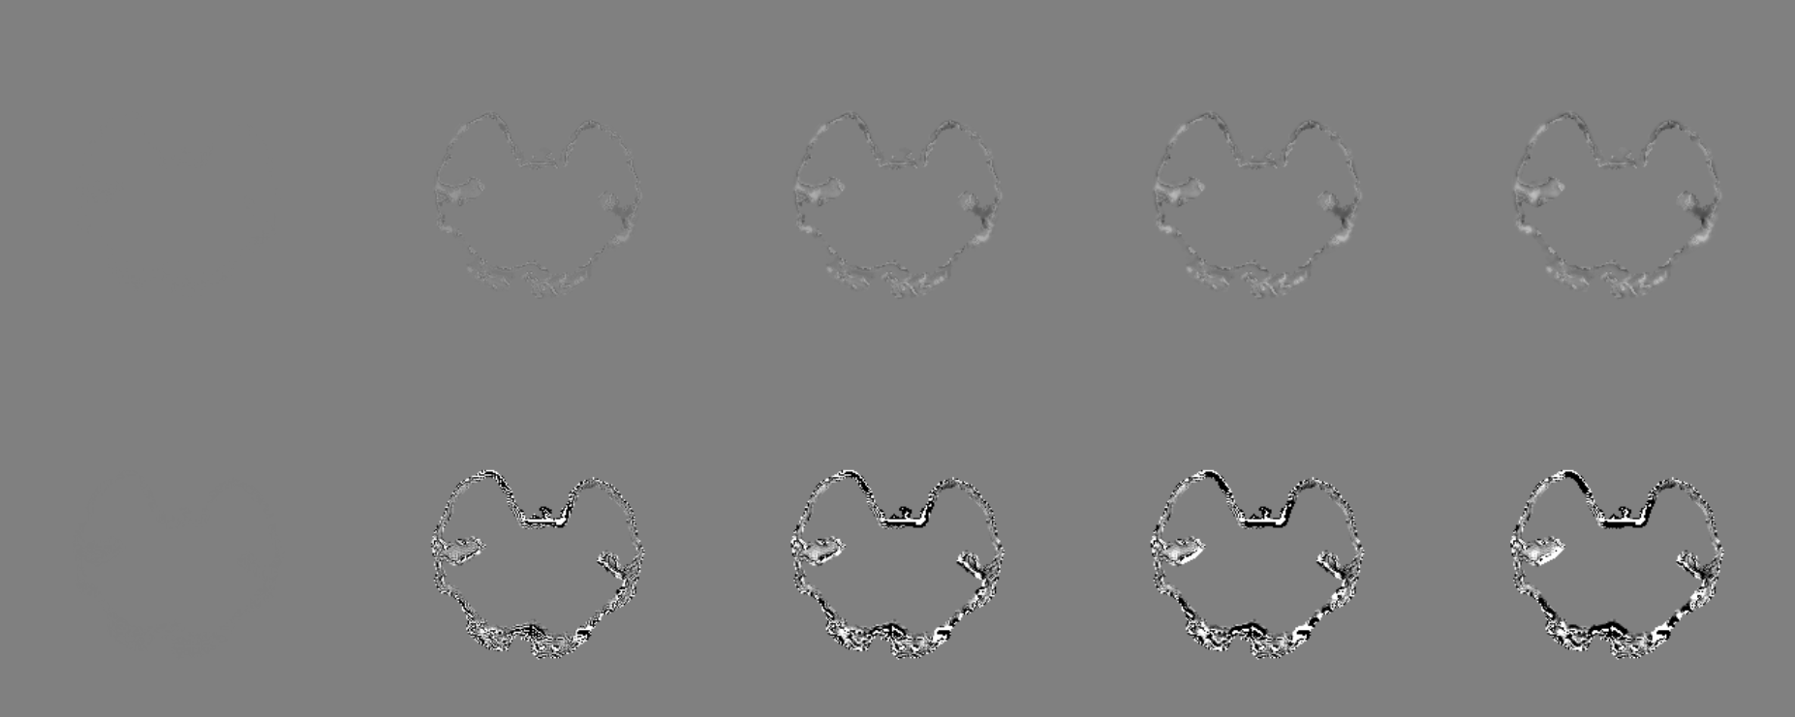

SMV filtered volumes ($b^{∗}$ slice)
$$∂M{|b_{L}^{0}\left(\vec{r}\right)−S}_{r^{′}=1}\left\{b_{L}^{0}\left(\vec{r}\right)\right\}|→S_{r^{′}=1}\sim δ(\vec{r})$$ | $$∂M{|b_{L}^{0}\left(\vec{r}\right)−S}_{r^{′}=2}\left\{b_{L}^{0}\left(\vec{r}\right)\right\}|$$ | $$∂M{|b_{L}^{0}\left(\vec{r}\right)−S}_{r^{′}=3}\left\{b_{L}^{0}\left(\vec{r}\right)\right\}|$$ | $$∂M{|b_{L}^{0}\left(\vec{r}\right)−S}_{r^{′}=4}\left\{b_{L}^{0}\left(\vec{r}\right)\right\}|$$ | $$∂M{|b_{L}^{0}\left(\vec{r}\right)−S}_{r^{′}=5}\left\{b_{L}^{0}\left(\vec{r}\right)\right\}|$$
$$∂M{|b_{L}\left(\vec{r}\right)−S}_{r^{′}=1}\left\{b_{L}\left(\vec{r}\right)\right\}|→S_{r^{′}=1}\sim δ(\vec{r})$$ | $$∂M{|b_{L}\left(\vec{r}\right)−S}_{r^{′}=2}\left\{b_{L}\left(\vec{r}\right)\right\}|$$ | $$∂M{|b_{L}\left(\vec{r}\right)−S}_{r^{′}=3}\left\{b_{L}\left(\vec{r}\right)\right\}|$$ | $$∂M{|b_{L}\left(\vec{r}\right)−S}_{r^{′}=4}\left\{b_{L}\left(\vec{r}\right)\right\}|$$ | $$∂M{|b_{L}\left(\vec{r}\right)−S}_{r^{′}=5}\left\{b_{L}\left(\vec{r}\right)\right\}|$$

Slide 48
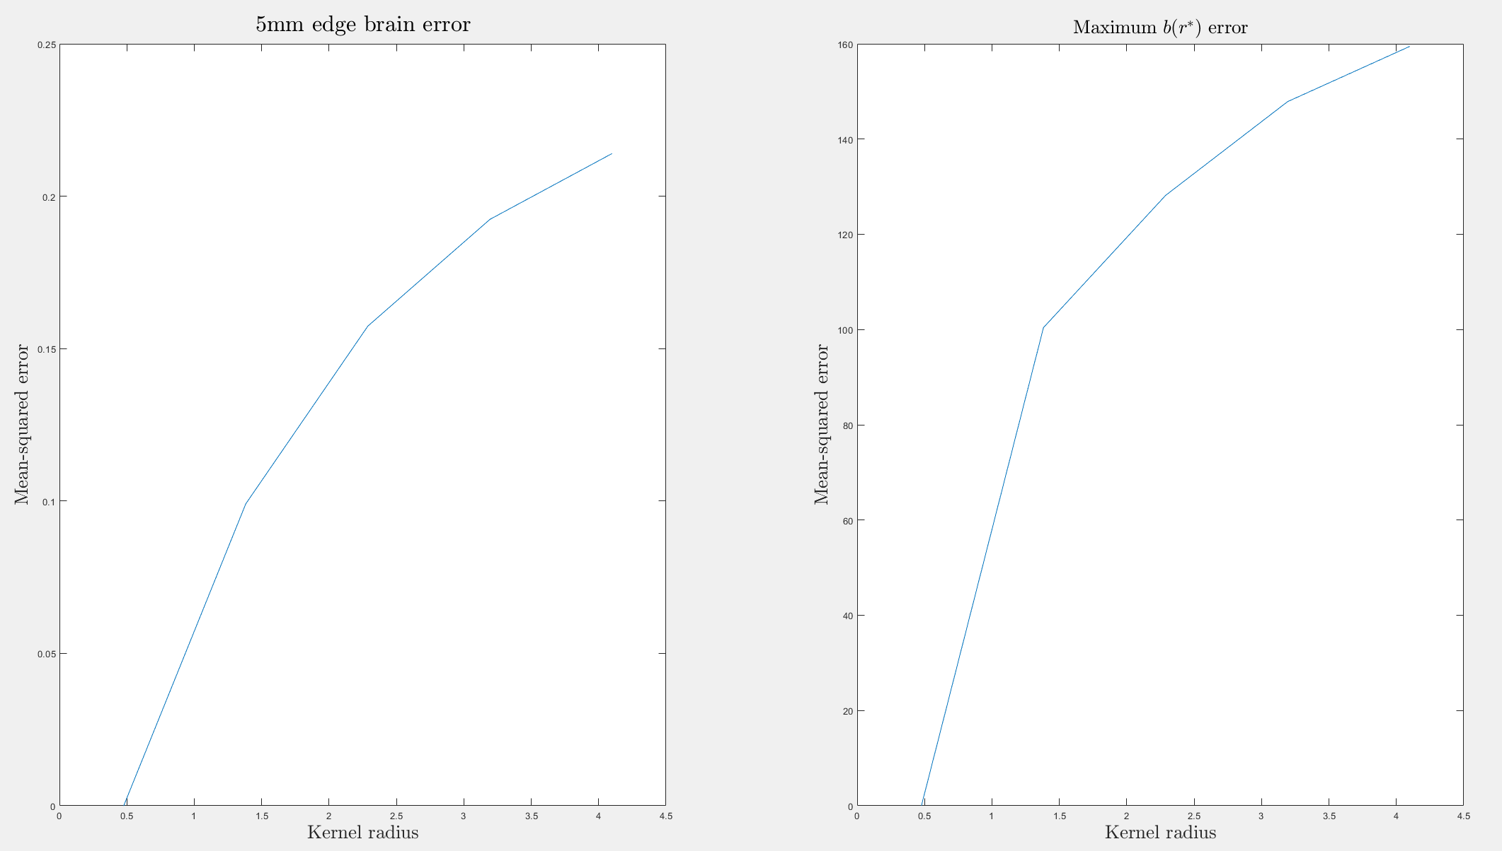
Output of SMV filtering

Slide 49
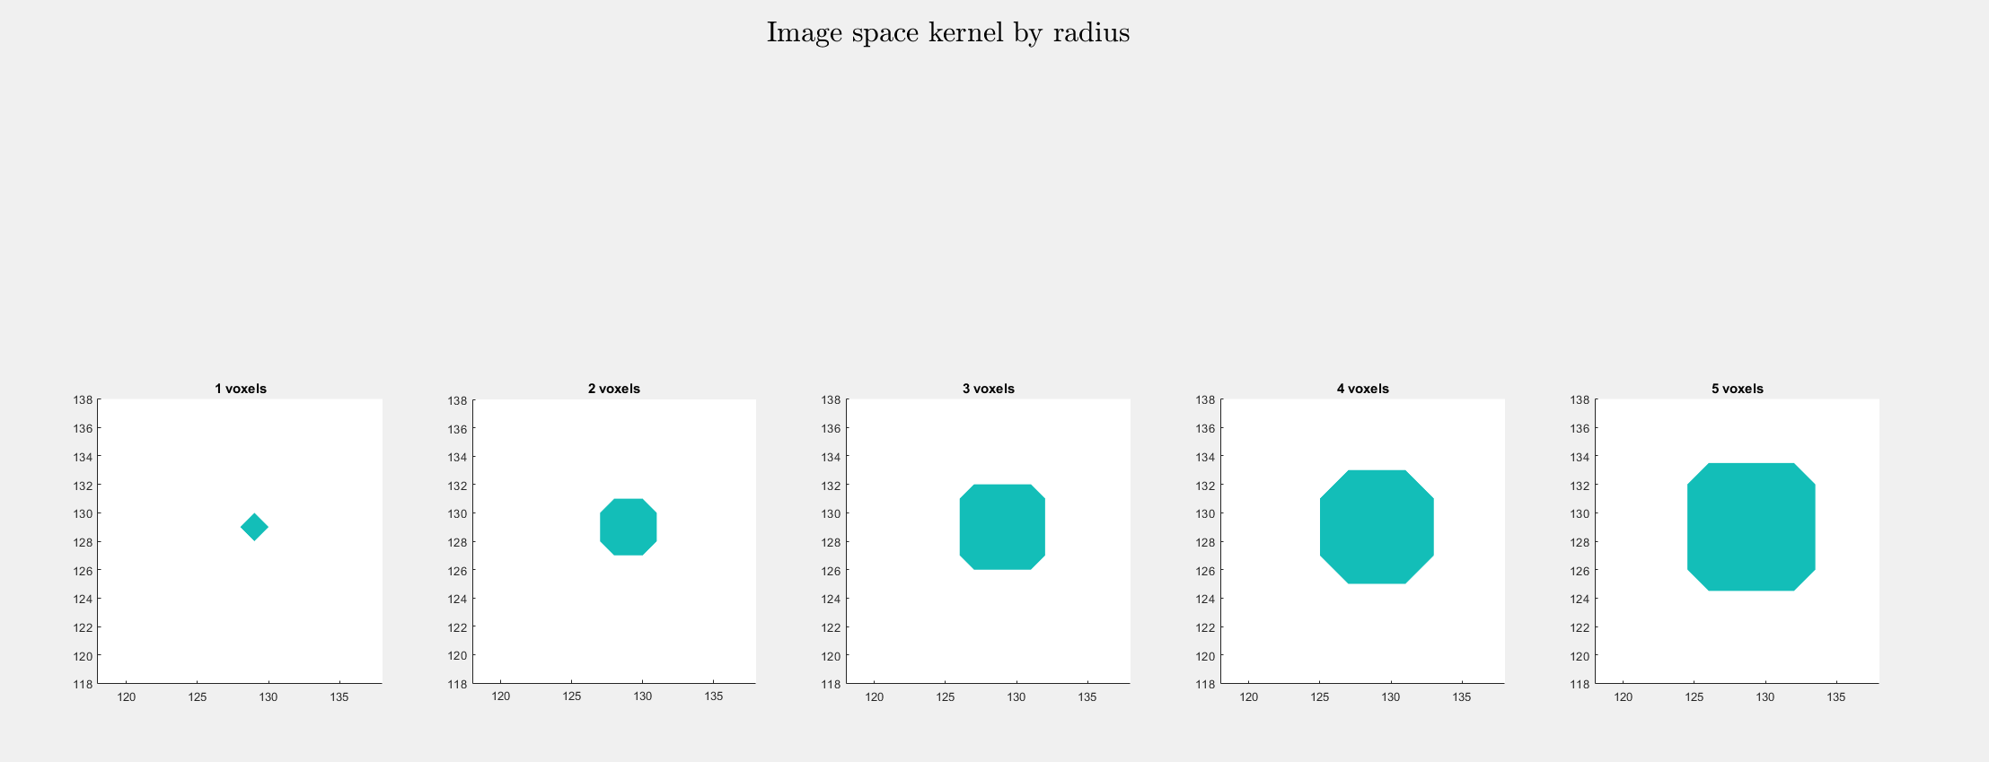
Spherical kernel dimensions

Slide 50
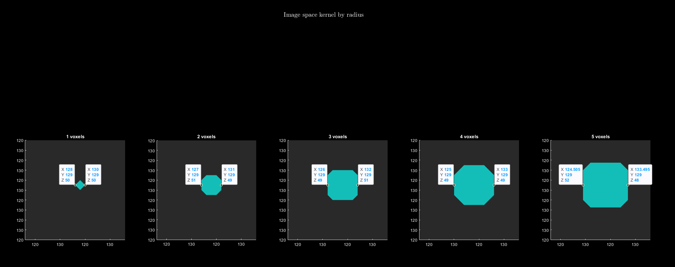
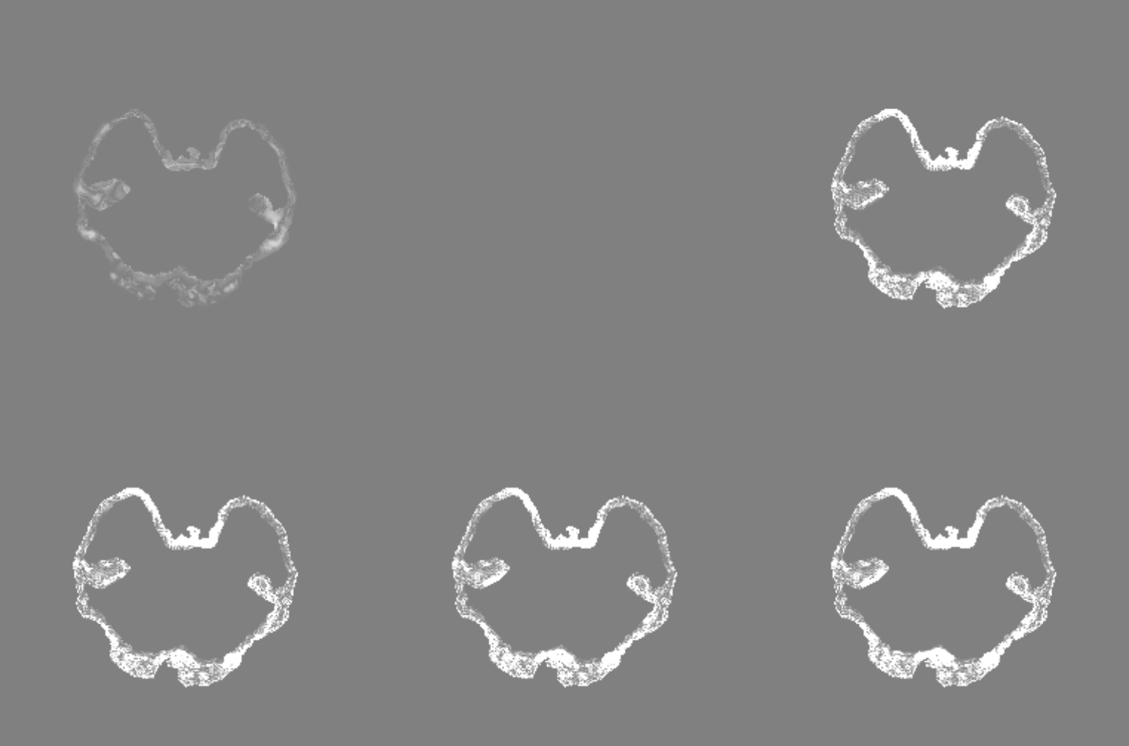







Output of SMV filtering
$∂M|b_{L}^{0}\left(\vec{r}\right)|$ Ground truth | $$∂M{{|b}_{L}\left(\vec{r}\right)−S}_{r^{′}=1}\left\{b_{L}\left(\vec{r}\right)\right\}|→S_{r^{′}=1}\sim δ(\vec{r})$$ | $$∂M{{|b}_{L}\left(\vec{r}\right)−S}_{r^{′}=2}\left\{b_{L}\left(\vec{r}\right)\right\}|$$
$${|b}_{L}^{0}\left(r^{∗}\right)|=0.005$$
$$|b_{L}^{r^{′}=2}\left(r^{∗}\right)|$$
$$b_{L}^{0}=b_{L}−S^{r^{′}=0}\left(b_{L}\right)$$
$$|b_{L}^{r^{′}=3}\left(r^{∗}\right)|$$
$$|b_{L}^{r^{′}=4}\left(r^{∗}\right)|$$
$$|b_{L}^{r^{′}=5}\left(r^{∗}\right)|$$
$$∂M{{|b}_{L}\left(\vec{r}\right)−S}_{r^{′}=3}\left\{b_{L}\left(\vec{r}\right)\right\}|$$ | $$∂M{{|b}_{L}\left(\vec{r}\right)−S}_{r^{′}=4}\left\{b_{L}\left(\vec{r}\right)\right\}|$$ | $$∂M{{|b}_{L}\left(\vec{r}\right)−S}_{r^{′}=5}\left\{b_{L}\left(\vec{r}\right)\right\}|$$
$$b_{T}−S\left(b_{T}\right)=b_{L}+b_{B}−S\left(b_{L}\right)−S\left(b_{B}\right)$$
$$b_{T}−S\left(b_{T}\right)=b_{L}−S\left(b_{L}\right)$$

Slide 51
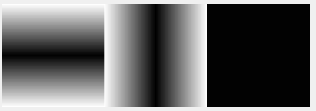
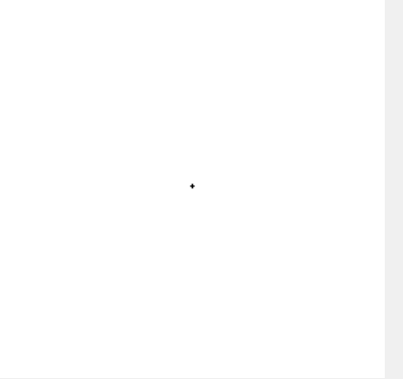





Sphere kernel function Assuming a sphere with center $(x_{0},y_{0},z_{0})$ and radius $r$ including all points $\left(x,y,z\right) s.t. { \left(x−x_{0}\right)}^{2}+{\left(y−y_{0}\right)}^{2}+{\left(z−z_{0}\right)}^{2}≤r^{2}$
function y = sphere_kernel(matrix_size,voxel_size, radius)
% Define image coordinates [256x256x98] (1)
[Y,X,Z]=meshgrid(-matrix_size(2)/2:matrix_size(2)/2-1,...
-matrix_size(1)/2:matrix_size(1)/2-1,...
-matrix_size(3)/2:matrix_size(3)/2-1);
% Convert to mm not voxels
X = X*voxel_size(1); Y = Y*voxel_size(2); Z = Z*voxel_size(3);
% Outside the sphere (2)
Sphere_out = ( max(abs(X)-0.5*voxel_size(1),0).^2 ...
+max(abs(Y)-0.5*voxel_size(2),0).^2 ...
+max(abs(Z)-0.5*voxel_size(3),0).^2 )>radius^2;
% Inside the sphere, zero at the minimum radius! Which is why machine epsilon $𝒪({10}^{−16})$ is returned!
% When X,Y,Z are 0, the smallest spherical volume for the given voxel size is returned
% If this spherical volume exceeds $r^{2}$, the sphere will be empty and $κ\left(\vec{r}\right)→δ(\vec{r})$
% In other words, if the value of $r^{2}<ν_{min}$, the sphere cannot be discretized at the current resolution
Sphere_in = ( (abs(X)+0.5*voxel_size(1)).^2 ...
+(abs(Y)+0.5*voxel_size(2)).^2 ...
+(abs(Z)+0.5*voxel_size(3)).^2 )<=radius^2;
% Intermediate variable
Sphere_mid = zeros(matrix_size);
% Such that error is controlled at <1/(2*10)
split = 10;
% Differently ordered meshgrid [20x20x20] (3)
% This could be an issue for anisotropic data in the axial plane
[X_v Y_v Z_v] = meshgrid(-split+0.5:split-0.5, -split+0.5:split-0.5, -split+0.5:split-0.5);
% Divide by 20 (interpolate by a factor of 2)
X_v = X_v/(2*split); Y_v = Y_v/(2*split); Z_v = Z_v/(2*split);
% Weight the shell sphere (4)
% Single voxel in the minimum radius case
shell = 1-Sphere_in-Sphere_out;
% Consider only values within the shell (sum of the shell)
% 19 in the minimum radius case
X = X(shell==1); Y = Y(shell==1); Z = Z(shell==1);
shell_val = zeros(size(X));
% Weight sphere shell by radius?
for i = 1:length(X)
xx = X(i); yy = Y(i); zz = Z(i);
% Check if the shell value + coordinates in mm are less than the radius?
% occupied 6 in the minimum radius case (5)
occupied = ( (xx+X_v*voxel_size(1)).^2+...
(yy+Y_v*voxel_size(2)).^2+...
(zz+Z_v*voxel_size(3)).^2)<=radius^2;
% Calculate a weight for each value in the shell
shell_val(i) = sum(occupied(:))/numel(X_v);
end
% Assign shell values
Sphere_mid(shell==1) = shell_val;
% Create weighted sphere
Sphere = Sphere_in+Sphere_mid;
% Normalize to unit ball
y = logical(Sphere/sum(Sphere(:)));
1
2
3
4
5

Slide 52


Sphere kernel function Assuming a sphere with center $(x_{0},y_{0},z_{0})$ and radius $r$ including all points $\left(x,y,z\right) s.t. { \left(x−x_{0}\right)}^{2}+{\left(y−y_{0}\right)}^{2}+{\left(z−z_{0}\right)}^{2}≤r^{2}$
function y = sphere_kernel(matrix_size,voxel_size, radius)
% Define image coordinates
[Y,X,Z]=meshgrid(-matrix_size(2)/2:matrix_size(2)/2-1,...
-matrix_size(1)/2:matrix_size(1)/2-1,...
-matrix_size(3)/2:matrix_size(3)/2-1);
% Convert to mm not voxels
X = X*voxel_size(1); Y = Y*voxel_size(2); Z = Z*voxel_size(3);
% Outside the sphere
Sphere_out = ( max(abs(X)-0.5*voxel_size(1),0).^2 ...
+max(abs(Y)-0.5*voxel_size(2),0).^2 ...
+max(abs(Z)-0.5*voxel_size(3),0).^2 )>radius^2;
% Inside the sphere, zero at the minimum radius! Which is why machine epsilon $𝒪({10}^{−16})$ is returned!
% When X,Y,Z are 0, the smallest spherical volume for the given voxel size is returned
% If this spherical volume exceeds $r^{2}$, the sphere will be empty and $κ\left(\vec{r}\right)→δ(\vec{r})$
% In other words, if the value of $r^{2}<ν_{min}$, the sphere cannot be discretized at the current resolution
Sphere_in = ( (abs(X)+0.5*voxel_size(1)).^2 ...
+(abs(Y)+0.5*voxel_size(2)).^2 ...
+(abs(Z)+0.5*voxel_size(3)).^2 )<=radius^2;
% Intermediate variable
Sphere_mid = zeros(matrix_size);
% Such that error is controlled at <1/(2*10)
split = 10;
% Differently ordered meshgrid [20x20x20] but grids are identical
[X_v Y_v Z_v] = meshgrid(-split+0.5:split-0.5, -split+0.5:split-0.5, -split+0.5:split-0.5);
% Divide by 20 to interpolate
X_v = X_v/(2*split); Y_v = Y_v/(2*split); Z_v = Z_v/(2*split);
% Weight the shell sphere (4)
% Single voxel in the minimum radius case
shell = 1-Sphere_in-Sphere_out;
% Consider only values within the shell (sum of the shell)
% 19 in the minimum radius case
X = X(shell==1); Y = Y(shell==1); Z = Z(shell==1);
shell_val = zeros(size(X));
% Weight sphere shell by radius?
for i = 1:length(X)
xx = X(i); yy = Y(i); zz = Z(i);
% Check if the shell value + coordinates in mm are less than the radius?
% occupied 6 in the minimum radius case
occupied = ( (xx+X_v*voxel_size(1)).^2+...
(yy+Y_v*voxel_size(2)).^2+...
(zz+Z_v*voxel_size(3)).^2)<=radius^2;
% Calculate a weight for each value in the shell
shell_val(i) = sum(occupied(:))/numel(X_v);
end
% Assign shell values
Sphere_mid(shell==1) = shell_val;
% Create weighted sphere
Sphere = Sphere_in+Sphere_mid;
% Normalize to unit ball
y = logical(Sphere/sum(Sphere(:)));
function $S_{M,ν,r}$
% Define image coordinates
$$\left[Y,X,Z\right]=\left\{−\frac{M_{y}}{2},…,\frac{M_{y}}{2};−\frac{M_{x}}{2},…,\frac{M_{x}}{2};−\frac{M_{z}}{2},…,\frac{M_{z}}{2}\right\}$$
% Convert to mm not voxels
$$X≔Xν_{x};Y≔Yν_{y};Z≔Zν_{z}$$
% Outside the sphere
$$S_{0}=\left\{\max{{\left(\left|X\right|−\frac{1}{2}ν_{x},0\right)}^{2}}+\max{{\left(\left|Y\right|−\frac{1}{2}ν_{y},0\right)}^{2}}+\max{{\left(\left|Z\right|−\frac{1}{2}ν_{z},0\right)}^{2}}\right\}>r^{2}$$
$$∴x_{0}≔\frac{1}{2}ν_{x}, y_{0}≔\frac{1}{2}ν_{y}, z_{0}≔\frac{1}{2}ν_{z}$$
% Inside the sphere, zero at the minimum radius! Which is why machine epsilon $𝒪({10}^{−16})$ is returned!
% When X,Y,Z are 0, the smallest spherical volume for the given voxel size is returned
% If this spherical volume exceeds $r^{2}$, the sphere will be empty and $κ\left(\vec{r}\right)→δ(\vec{r})$
% In other words, if the value of $r^{2}<ν_{min}$, the sphere cannot be discretized at the current resolution
$$S_{i}=\left\{{\left(\left|X\right|+\frac{1}{2}ν_{x}\right)}^{2}+{\left(\left|Y\right|+\frac{1}{2}ν_{y}\right)}^{2}+{\left(\left|Z\right|+\frac{1}{2}ν_{z}\right)}^{2}\right\}≤r^{2}$$
% Intermediate variable
$$S_{m}=\vec{0}⊙M$$
% Such that error is controlled at <1/(2*10)
$$ζ=10$$
% Differently ordered meshgrid [20x20x20] but grids are identical
$$[X_{v}, Y_{v}, Z_{v}] = \left\{−ζ+\frac{1}{2},…,ζ−\frac{1}{2};−ζ+\frac{1}{2},…,ζ−\frac{1}{2};−ζ+\frac{1}{2},…,ζ−\frac{1}{2}\right\}$$
% Divide by 20 to interpolate
$$X_{v}≔\frac{X_{v}}{2ζ}, Y_{v}=\frac{Y_{v}}{2ζ}, Z_{v}=\frac{Z_{v}}{2ζ}$$
% Weight the shell sphere
% Single voxel in the minimum radius case
$$dS=1−S_{i}−S_{o}$$
% Consider only values within the shell (sum of the shell)
% 19 in the minimum radius case
$$X≔X\left(dS=1\right);Y≔Y\left(dS=1\right);Z≔Z(dS=1)$$
$$dS_{v}=\vec{0}⊙X$$
% Weight sphere shell by radius?
% Check if the shell value + coordinates in mm are less than the radius?
% occupied 6 in the minimum radius case
$$S_{∂v}\left(i\right)={\left(X\left(i\right)+X_{v}v_{x}\right)}^{2}+{\left(Y\left(i\right)+Y_{v}v_{y}\right)}^{2}+{\left(Z\left(i\right)+Z_{v}v_{z}\right)}^{2}≤r^{2}$$
% Calculate a weight for each value in the shell
$$dS\left(i\right)=\sum{\frac{S_{∂v}}{N_{X_{v}}}}$$
% Assign shell values
$$S_{m}\left(dS=1\right)=S_{∂v}$$
% Create weighted sphere
$$S=S_{i}+S_{m}$$
% Normalize to unit ball
$$S_{M,ν,r}=\frac{S}{\sum{S}}$$

Slide 53

Sphere kernel function

